Slide 1
Web Services Concepts
Copyright - http://soatraining.hpage.com

Slide 2
Objectives
After completing this lesson, you should be able to do the following:
  Understand power of web services
  Understand WSDL
  Understand SOAP
Copyright - http://soatraining.hpage.com

Slide 3
Introducing Web Services
Web services are:
  Self-describing business functions
  Accessible from any Web-connected device using:
    Messaging Protocols – The messaging protocols are standards-based and are platform independent. These enable one service to call another one - SOAP over HTTP, JMS
    Programming standards – The underlying programming standards help create services that conform to a predefined structure. This means it is possible to figure out what the service does in a platform and language independent way. - WSDL
    Network registration – The services can be searched in a common way - UDDI
Copyright - http://soatraining.hpage.com
Notes:
A business service is a “logical encapsulation of business function”. In simple terms, it means that you wrap up everything you have to do to make a particular business function happen and give that rolled-up something a name and call it a business service.
Messaging Protocols – The messaging protocols are standards-based and are platform independent. These enable one service to call another one
- SOAP over HTTP, JMS
Programming standards – The underlying programming standards help create services that conform to a predefined structure. This means it is possible to figure out what the service does in a platform and language independent way.
- WSDL
Network registration – The services can be searched in a common way
- UDDI

Slide 4

Web Services Communication Flow
Citibank
Bill Payment
Service
3
Find
4
Invoke
SOAP
Web Services
Directory
(UDDI)
Internet
5
Communicating
the response
2
Register
Interface (WSDL)
1
Publish
Application Program
(Service Implementation)
Vodafone Bill Payment Service
Copyright - http://soatraining.hpage.com
Notes:
To understand how web services work, lets take an example.
Scenario – A Citibank customer wants to pay his Vodafone phone bill through the bank’s website.
Solution
First, the Vodafone IT team would create a service that allows one to pay their bills through a web service. This service may be implemented in any way they please, using ADF, POJO, PL/SQL etc. However, the service needs to expose its interface according to WSDL specification
In order to facilitate clients to be able to find this service, the Vodafone team publishes this WSDL to a web services directory. The directory is capable of storing different kind of information like the request and response messages, version, publisher details, type of service etc. All this information is structured in a standard way so that interested parties can search or discover them. This common format is the UDDI
Citibank IT team, which is developing their website, and want to provide this service to their customer, finds the service developed by Vodafone team. This completes the setup.
When a customer chooses to pay his bill, the required information is sent to the Vodafone Bill Payment web service. This communication is done using a SOAP message. As SOAP can work over HTTP, which is the most used protocol on the Internet, this invocation can utilize the power of Internet
The Vodafone Bill Payment service acknowledges success or failure of the transaction
The above example brings out the interplay of:
Messaging protocols - SOAP
Programming standards – Interface based on WSDL standard
Network registration – Information stored as per UDDI standard
Note: A Public Registry, while a really cool concept, didn’t really take off as expected. However, the concept itself found takers at organization level and typically an organization that takes its SOA seriously will have a registry setup.

Slide 5
Web Services Communication Flow Example
To understand how web services work, lets take an example.
Scenario – A Citibank customer wants to pay his Vodafone phone bill through the bank’s website.
Solution
First, the Vodafone IT team would create a service that allows one to pay their bills through a web service. This service may be implemented in any way they please, using ADF, POJO, PL/SQL etc. However, the service needs to expose its interface according to WSDL specification
In order to facilitate clients to be able to find this service, the Vodafone team publishes this WSDL to a web services directory. The directory is capable of storing different kind of information like the request and response messages, version, publisher details, type of service etc. All this information is structured in a standard way so that interested parties can search or discover them. This common format is the UDDI
Citibank IT team, which is developing their website, and want to provide this service to their customer, finds the service developed by Vodafone team. This completes the setup.
When a customer chooses to pay his bill, the required information is sent to the Vodafone Bill Payment web service. This communication is done using a SOAP message. As SOAP can work over HTTP, which is the most used protocol on the Internet, this invocation can utilize the power of Internet
The Vodafone Bill Payment service acknowledges success or failure of the transaction
The above example brings out the interplay of:
    Messaging protocols - SOAP
    Programming standards – Interface based on WSDL standard
    Network registration – Information stored as per UDDI standard
    Note: A Public Registry, while a really cool concept, didn’t really take off as expected. However, the concept itself found takers at organization level and typically an organization that takes its SOA seriously will have a registry setup.
Copyright - http://soatraining.hpage.com

Slide 6
Describing a web service
Lets understand what it takes to describe a web service. If we can appreciate these, then understanding why WSDL looks like it does would be that much simpler.
Requirement 1: We need to tell what is the location of this web service
Requirement 2: We need to tell what is the language the web service speaks
Requirement 3: We need to tell what functions or operations this web service is providing
Requirement 4: We need to tell what input and output parameters the service takes
Requirement 5: We need to tell the datatype of these parameters
Copyright - http://soatraining.hpage.com

Slide 7
WSDL Enters….
A WSDL document is just a simple XML document.
It contains set of definitions to describe a web service.
WSDL document fulfills all the above requirements
  Requirement 1 – Where is the service hosted
    <service>
  Requirement 2 – What protocol to use to talk to the service
    <binding>
  Requirement 3 – What are the operations
    <portType>
  Requirement 4 – What are the parameters
    <message>
  Requirement 5 – What is the datatype of the messages
    <type>
Copyright - http://soatraining.hpage.com

Slide 8
Introducing WSDL
WSDL stands for Web Services Description Language
WSDL is written in XML
WSDL is used to describe Web services
WSDL is also used to locate Web services
WSDL is a W3C recommendation
Copyright - http://soatraining.hpage.com
Notes:
WSDL is a document written in XML. The document describes a Web service. It specifies the location of the service and the operations (or methods) the service exposes.

Slide 9
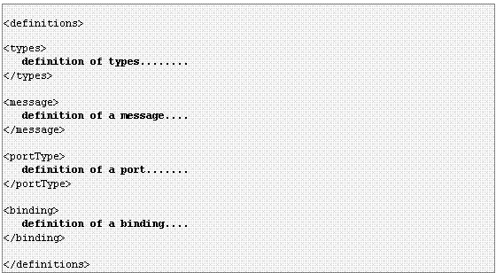
WSDL Document Structure
Copyright - http://soatraining.hpage.com

Slide 10

WSDL Ports
The <portType> element is the most important WSDL element.
It describes a web service, the operations that can be performed, and the messages that are involved.
The <portType> element can be compared to a function library (or a module, or a class) in a traditional programming language
Copyright - http://soatraining.hpage.com

Slide 11
Operation Types
Type
Definition
One-way
The operation can receive a message but will not return a response
Request-response
The operation can receive a request and will return a response
Solicit-response
The operation can send a request and will wait for a response
Notification
The operation can send a message but will not wait for a response
Copyright - http://soatraining.hpage.com
Notes:
The W3C WSDL Specification defines four message patterns to support four types of operations, as follows:
Request-response
One-way
Notification
Solicit-response
Message Patterns and Asynchronicity
The request-response and the solicit-response patterns are generally synchronous, as their usage usually assumes that the requestor will receive an immediate response.
The one-way and the notification patterns are inherently asynchronous in that the requestor expects no response.
While one of the strengths of WSDL is that it allows any mix of message patterns and transports in a single service, it is important to be aware that the behavior of a service is tied to the type of transport being used. For example, an asynchronous service will not behave asynchronously if it is sent using a synchronous transport, such as HTTP. This is because HTTP requires a response as a receipt.
For this reason, it may be wise to build one-way and notification messages asynchronously even though no response is required, in order to avoid having the client block for a transport receipt

Slide 12
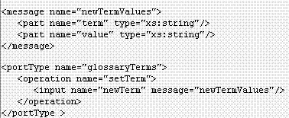
One-way operation type
The operation can receive a message but will not return a response
Copyright - http://soatraining.hpage.com
Notes:
In this example the port "glossaryTerms" defines a one-way operation called "setTerm".
The "setTerm" operation allows input of new glossary terms messages using a "newTermValues" message with the input parameters "term" and "value". However, no output is defined for the operation.

Slide 13
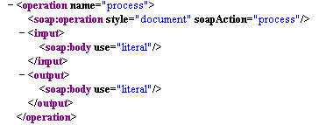
Request-response operation type
The operation can receive a request and will return a response
Copyright - http://soatraining.hpage.com
Notes:
In this example the port "glossaryTerms" defines a request-response operation called "getTerm".
The "getTerm" operation requires an input message called "getTermRequest" with a parameter called "term", and will return an output message called "getTermResponse" with a parameter called "value".

Slide 14
Now, a web service operation can take only one parameter. But I want to pass multiple parameters……what do I need to do
Copyright - http://soatraining.hpage.com

Slide 15

WSDL Messages
The <message> element defines the data elements of an operation.
Each message can consist of one or more parts. The parts can be compared to the parameters of a function call in a traditional programming language.
Copyright - http://soatraining.hpage.com

Slide 16
I want to pass a complex object to my web service……what do I need to do
Copyright - http://soatraining.hpage.com

Slide 17

WSDL Types
The <types> element defines the data type that are used by the web service.
For maximum platform neutrality, WSDL uses XML Schema syntax to define data types.
Copyright - http://soatraining.hpage.com

Slide 18
I want my web service to be accessible to a HTTP client, as well as to a RMI client and a SOAP client……what do I need to do
Copyright - http://soatraining.hpage.com

Slide 19
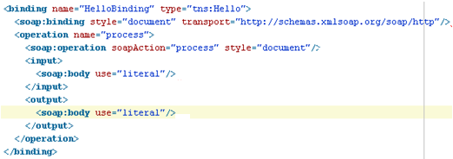
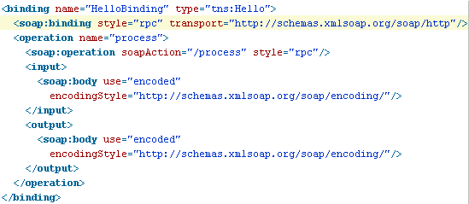
WSDL Bindings
The <binding> element defines the message format and protocol details for each port.
binding
  name – can be anything
  Type – points to port
soap:binding
  Style – rpc or document
  Transport – soap protocol to use
operation
  Defines each operation the the service exposes
Copyright - http://soatraining.hpage.com
Notes:
The binding element has two attributes - the name attribute and the type attribute.
The name attribute (you can use any name you want) defines the name of the binding, and the type attribute points to the port for the binding, in this case the "glossaryTerms" port.
he sample below shows the basic outline of a binding for a SOAP message:
<binding name="BindingName" type="PortTypeRef">
<soap:binding style="rpc|document" transport="http://schemas.xmlsoap.org/soap/http"/>
<operation name="OperationName">
<soap:operation soapAction="ActionValue"/>
<input>
<soap:body encodingStyle="http://schemas.xmlsoap.org/soap/encoding/" namespace="TargetNamespace" use="encoded"/>
</input>
<output>
<soap:body encodingStyle="http://schemas.xmlsoap.org/soap/encoding/" namespace="TargetNamespace" use="encoded"/>
</output>
</operation>
</binding>
The soap:binding element has two attributes - the style attribute and the transport attribute.
The style attribute can be "rpc" or "document". In the slide, we use document. The transport attribute defines the SOAP protocol to use. In the slide we use HTTP.
The operation element defines each operation that the port exposes.
The name sets the name of the operation this binding applies to. This name must match the name of an operation declared within the portType referenced in type attribute of binding.
For each operation the corresponding SOAP action has to be defined. You must also specify how the input and output are encoded. In this case we use "literal".

Slide 20
WSDL Bindings
The <binding> element provides specific details on how a portType operation will actually be transmitted over the wire.
The bindings can be made available via multiple transports, including HTTP GET, HTTP POST, or SOAP.
The bindings provide concrete information on what protocol is being used to transfer portType operations.
For SOAP protocol, the binding is <soap:binding>, and the transport is SOAP messages on top of HTTP protocol.
  WSDL 1.1 includes built-in extensions for SOAP 1.1. This enables you to specify SOAPspecific details, including SOAP headers, SOAP encoding styles, and the SOAPAction HTTP header. The SOAP extension elements include:
    soap:binding
    soap:operation
    soap:body
You can specify multiple bindings for a single portType.
Copyright - http://soatraining.hpage.com

Slide 21

WSDL Services
The <services> element connects the binding to an actual URL where the service is available.
A service element describes a Web service as a collection of port elements. A port element defines a specific network address for a binding. The sample below shows the basic outline of a service that supplies an address for a SOAP binding:
<service name="ServiceName">
<port name="PortName" binding="BindingRef">
<soap:address location="URL"/>
</port>
</service>
The ServiceName sets the name of the service. The PortName sets the name of the specific address. The BindingRef refers to the name of a binding element. The BindingRef must be namespace qualified if the targetNamespace for the WSDL definitions element is not the same as the default namespace.
Copyright - http://soatraining.hpage.com
Notes:
A service element describes a Web service as a collection of port elements. A port element defines a specific network address for a binding. The sample below shows the basic outline of a service that supplies an address for a SOAP binding:
<service name="ServiceName">
<port name="PortName" binding="BindingRef">
<soap:address location="URL"/>
</port>
</service>
The ServiceName sets the name of the service. The PortName sets the name of the specific address. The BindingRef refers to the name of a binding element. The BindingRef must be namespace qualified if the targetNamespace for the WSDL definitions element is not the same as the default namespace.

Slide 22
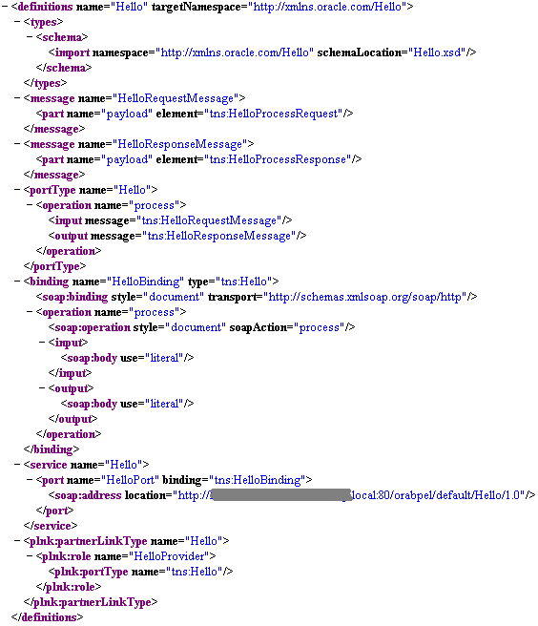
Complete WSDL Example
Copyright - http://soatraining.hpage.com

Slide 23
SOAP
SOAP stands for Simple Object Access Protocol
SOAP is a communication protocol
SOAP is for communication between applications
SOAP is a format for sending messages
SOAP communicates via Internet
SOAP is platform independent
SOAP is language independent
SOAP is based on XML
Relies on other Application Layer protocols (most notably Remote Procedure Call (RPC) and HTTP) for message negotiation and transmission.
SOAP is a W3C recommendation
Copyright - http://soatraining.hpage.com

Slide 24
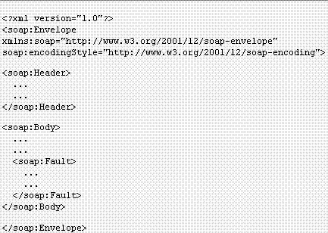
SOAP Message Structure
SOAP Envelope - encloses payload
SOAP Header - encloses Headers
SOAP body contains
SOAP message name and data
Copyright - http://soatraining.hpage.com
Notes:
SOAP Overview
A SOAP message is an ordinary XML document containing the following elements:
An Envelope element that identifies the XML document as a SOAP message
A Header element that contains header information
A Body element that contains call and response information
A Fault element containing errors and status information

Slide 25
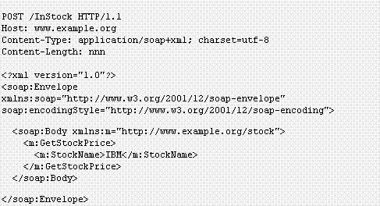
SOAP Request
Copyright - http://soatraining.hpage.com

Slide 26
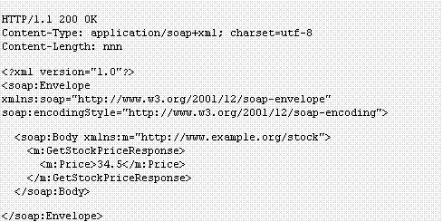
SOAP Response
Copyright - http://soatraining.hpage.com

Slide 27
UDDI
UDDI stands for Universal Description, Discovery and Integration.
The UDDI specification enables businesses to quickly, easily, and dynamically find and transact with one another.
UDDI enables a business to
  Describe its business and its services,
  Discover other businesses that offer desired services
  Integrate with these other businesses.
Copyright - http://soatraining.hpage.com
Notes:
UDDI defines a framework to enable the establishment of service registries to provide distributed directory service to the producers and consumers of Web services. It includes a common set of SOAP-based APIs to support registration and advertisement of Web services by service producers, and to facilitate the searching and lookup of Web services by service consumers.

Slide 28
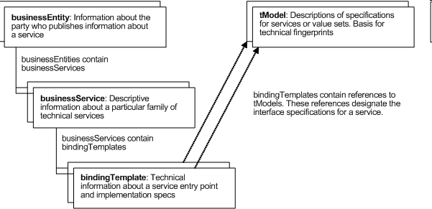
UDDI Data Model
The information that makes up a UDDI registry consists of instances of four core data structure types, the businessEntity, the businessService, the bindingTemplate and the tModel, together with instances of additional data structure types defined in the UDDI API Schema.
Each of the core data structure types is used to express specific types of data, arranged in the relationship shown
Copyright - http://soatraining.hpage.com
Notes:
The information that makes up a UDDI registry consists of instances of four core data structure types, the businessEntity, the businessService, the bindingTemplate and the tModel, together with instances of additional data structure types defined in the UDDI API Schema.
Each of the core data structure types is used to express specific types of data, arranged in the relationship shown

Slide 29
Why do we need a registry
The ability to register, discover, and govern Web services is an essential requirement for any Service Oriented Architecture (SOA) implementation.
A highly available environment contains multiple application server nodes, multiple instances, and multiple processes. Regardless of where the services will be deployed they have to be flexible enough to run anywhere without requiring changes to the actual process implementation.
This need may not be fully appreciated in the early stages of an SOA roll-out when dealing with a small number of services.
However, large organizations will typically need to support a large number of Web services, and as the number of services deployed grows to dozens or hundreds, centralized facilities for access and control of service metadata and artifacts becomes critical.
A service registry provides these capabilities and is a key infrastructural component and cornerstone for SOA deployments
Copyright - http://soatraining.hpage.com

Slide 30
Registry and UDDI
UDDI defines a framework to enable the establishment of service registries to provide distributed directory service to the producers and consumers of Web services. It includes a common set of SOAP-based APIs to support registration and advertisement of Web services by service producers, and to facilitate the searching and lookup of Web services by service consumers.
Copyright - http://soatraining.hpage.com

Slide 31
Resources
People and companies develop web services. Some of them are free too ☺
  http://www.webservicex.net/stockquote.asmx
  Links to lotsa web services on one page ! http://www.actionscript.org/forums/showthread.php3?t=70742
  Softwares
    http://download.oracle.com/otn/nt/oracle10g/xe/10201/OracleXE.exe
    http://download.oracle.com/otn/nt/ias/101310/soa_windows_x86_101310_disk1.zip
    http://download.oracle.com/otn/nt/ias/101350/ias_windows_x86_101350.zip
    http://www.oracle.com/technology/software/products/jdev/htdocs/soft10135.html please download the one which has JDK too
Copyright - http://soatraining.hpage.com

Slide 32
References
WSDL Tutorial - http://www.w3schools.com/WSDL/default.asp
SOAP Tutorial http://www.w3schools.com/soap/default.asp
More on WSDL elements http://www2.roguewave.com/support/docs/leif/leif/html/leifug/B-6.html
Copyright - http://soatraining.hpage.com

Slide 33
Extra Slides
Copyright - http://soatraining.hpage.com

Slide 34
Open System Interconnection Reference Model
http://en.wikipedia.org/wiki/OSI_model
It is an abstract description for layered communications and computer network protocol design
Copyright - http://soatraining.hpage.com

Slide 35
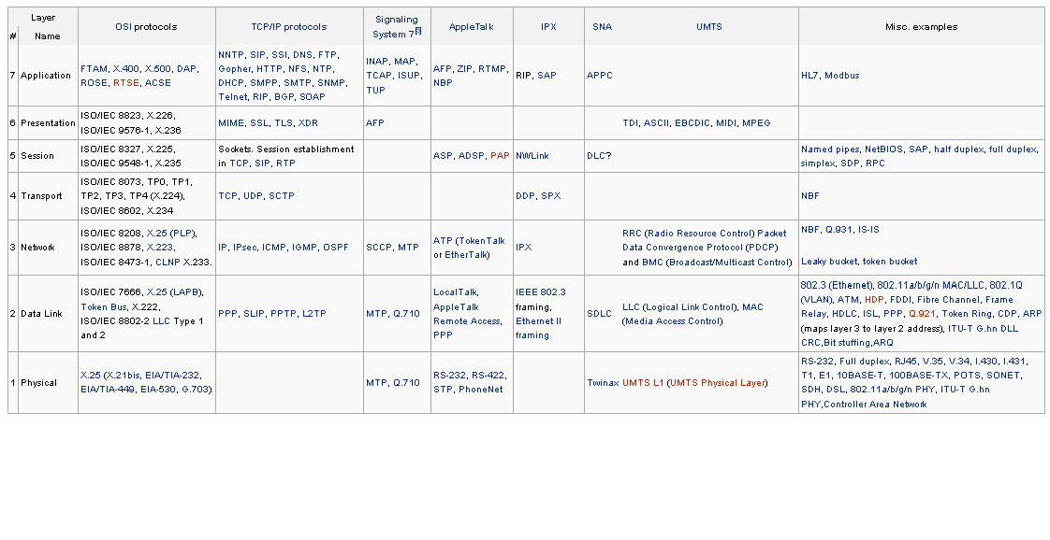
Examples of Protocols in each layer
Copyright - http://soatraining.hpage.com

